Slide 1



Task 3- Power BI Project
Mentorness
AIRPLANE CRASH ANALYSIS
By Meenakshi B
MIP-DA-06

Slide 2
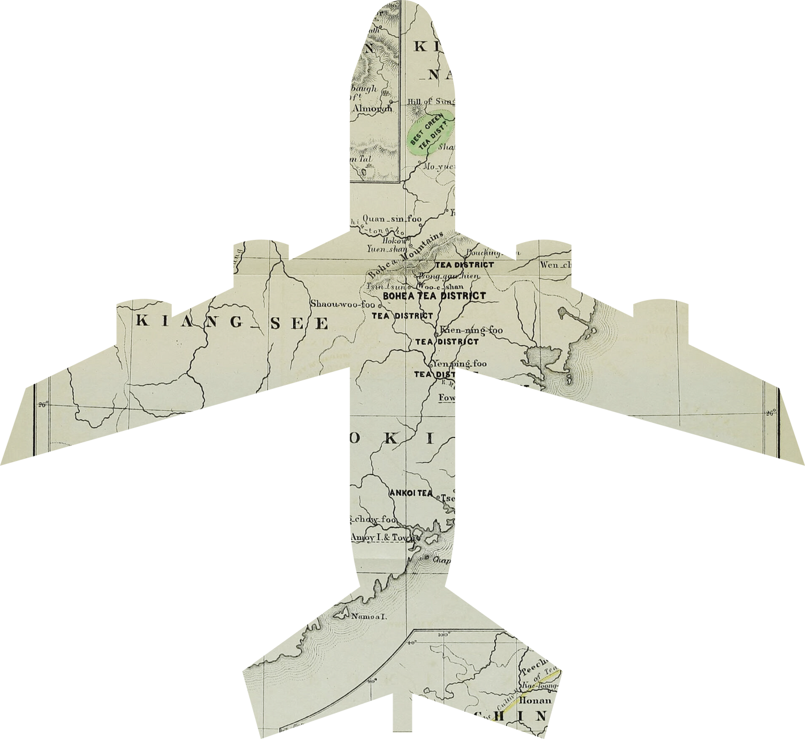
Airplane incidents can have severe consequences and impact not only the aviation industry but also the public. Therefore, it is crucial to analyze and understand the causes and contributing factors of these incidents to prevent them from happening in the future.

Slide 3
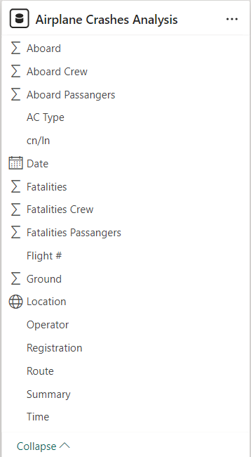
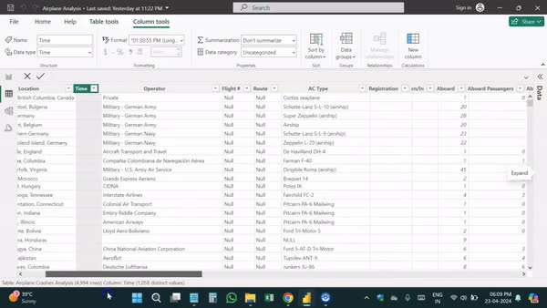
Data Preprocessing
Modifying data types for fields such as dates, time, location, and numerics, while managing missing values and eliminating unnecessary columns, are essential data processing techniques in Analysis.

Slide 4
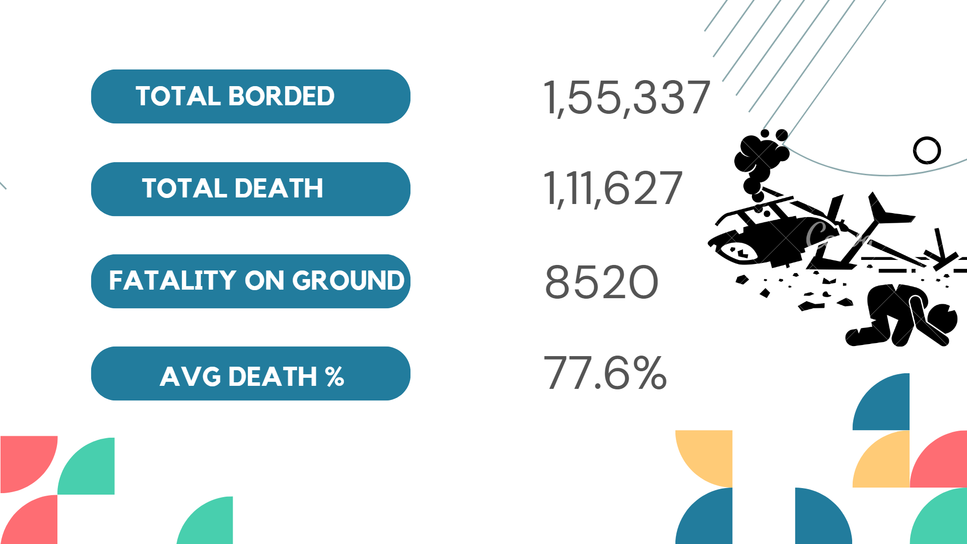




1,55,337
TOTAL BORDED
1,11,627
TOTAL DEATH
FATALITY ON GROUND
8520
77.6%
AVG DEATH %
AVG DEATH %

Slide 5
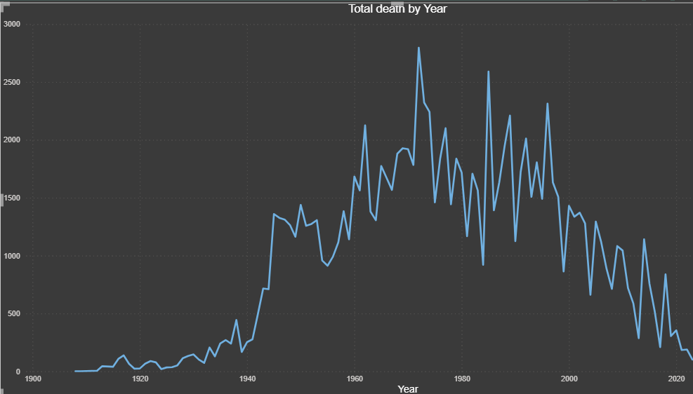

Slide 6
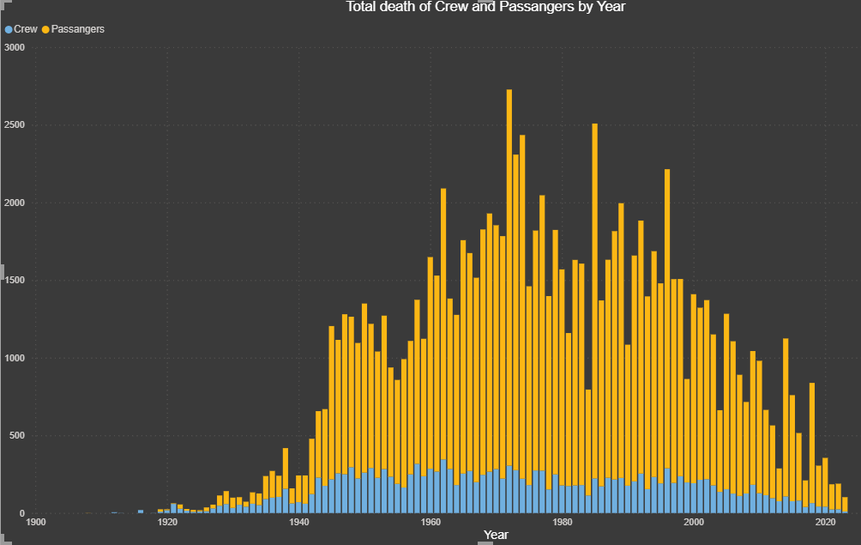

Lorna Alvarado

Slide 7
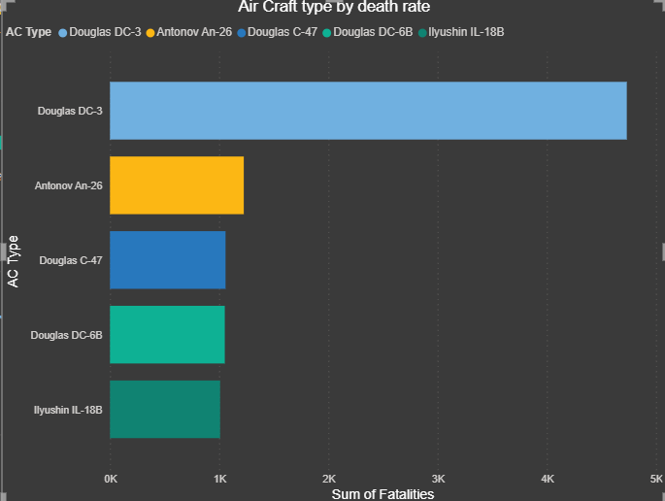
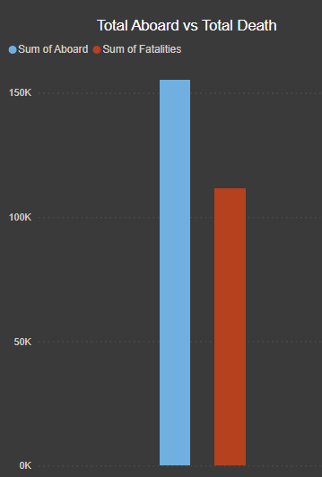
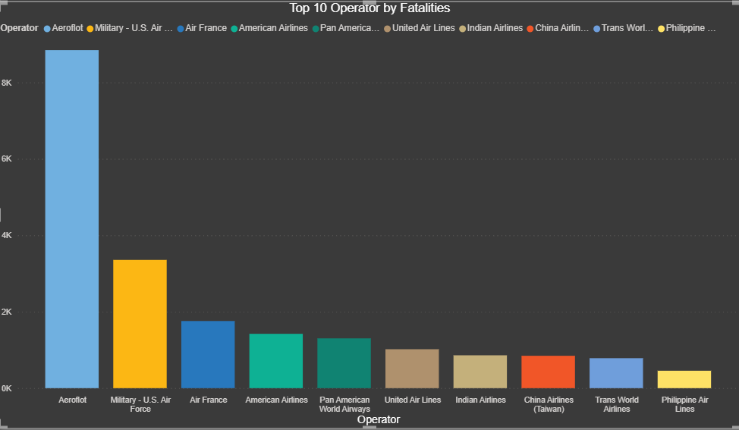

Slide 8
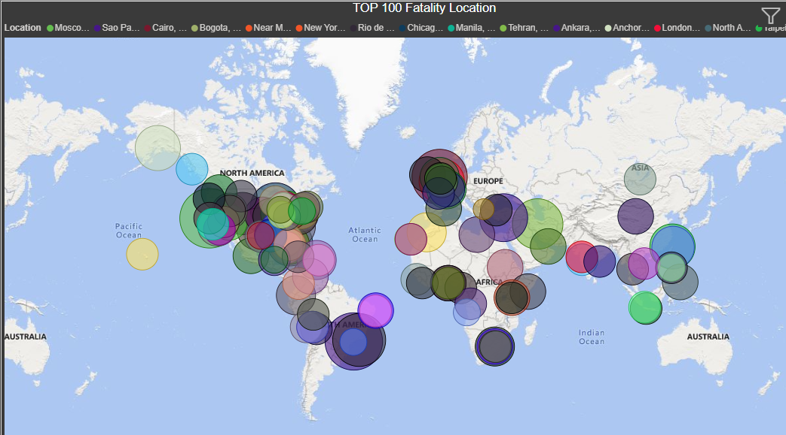
Lorna Alvarado

Slide 9

CONCLUSION
Yearly trends suggest fluctuations in the number of airplane incidents, indicating potential factors influencing aviation safety.
Geographical analysis reveals insights into regions and cities with higher incident rates.
Common aircraft types and operators associated with
incidents are identified.
Fatality analysis indicates periods with higher fatality rates, prompting further investigation into contributing factors.
Analysis of probable causes provides valuable insights into recurrent issues, helping inform safety measures.

Slide 10

THANK YOU

